Slide 1
Word embeddings
How it’s made?

Slide 2
Problem statement
How to make language computer readable?

Slide 3
Naive Ideas
Assign random IDs to words
eat:1, apple:2, milk:3, drink:4
apple + apple = drink ???
Treat words as categorical, independent variables
eat:[1,0,0,0] apple:[0,1,0,0] milk:[0,0,1,0] drink:[0,0,0,1]

Slide 4
Problem statement
How to make language computer readable?
How to encode meaning and similarity

Slide 5
Desired solution
A vector space with axis of “meaning” (semantic features)
Similar words are closer in the vector space than non-similar words

Slide 6
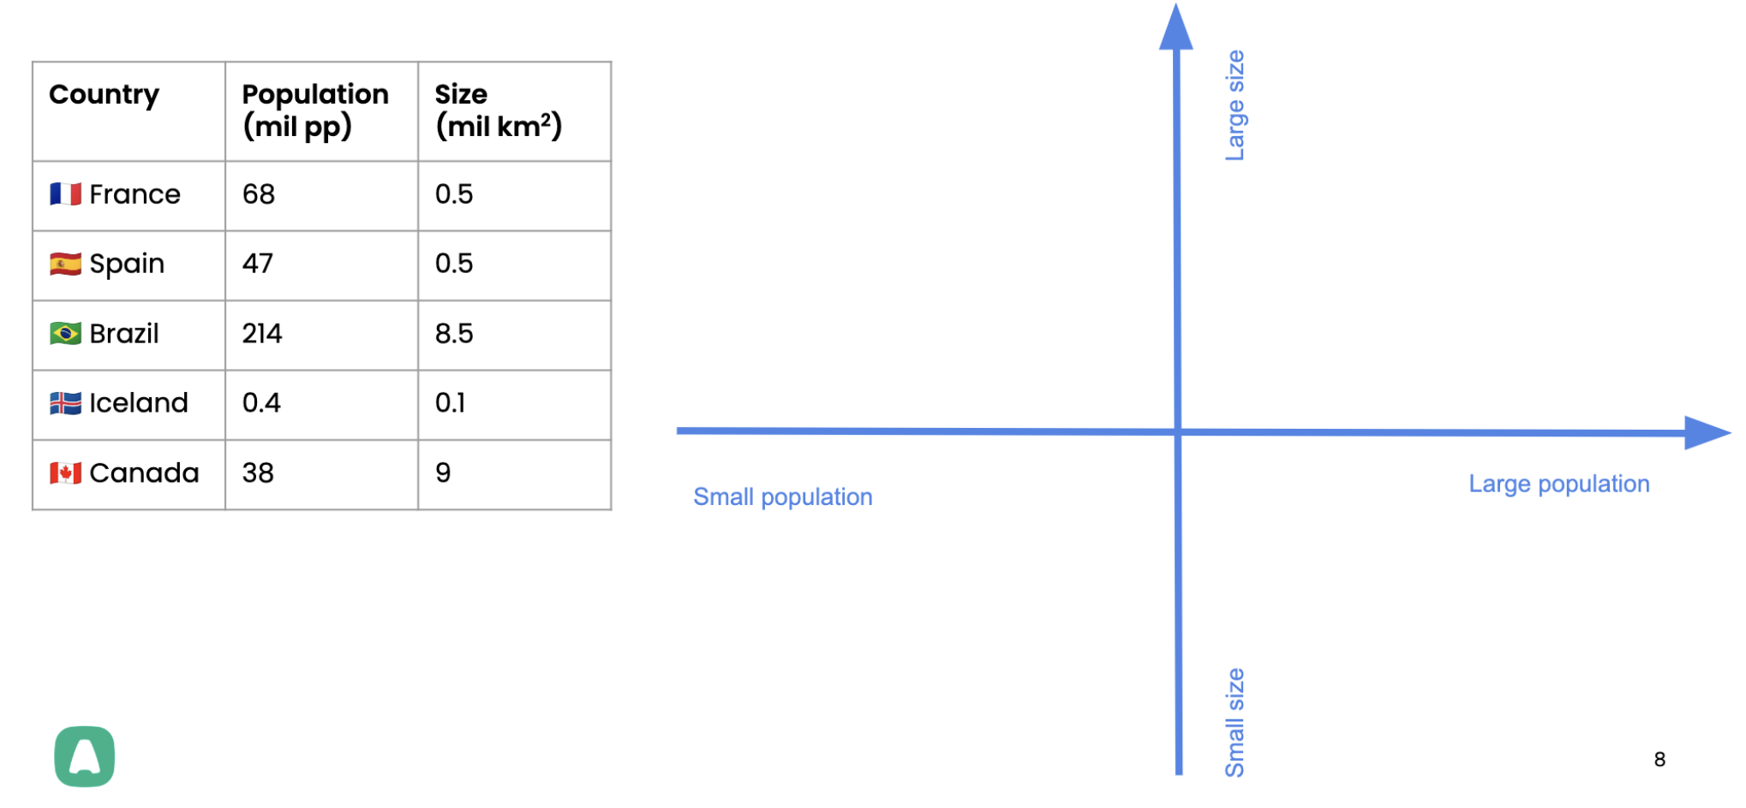

Slide 7
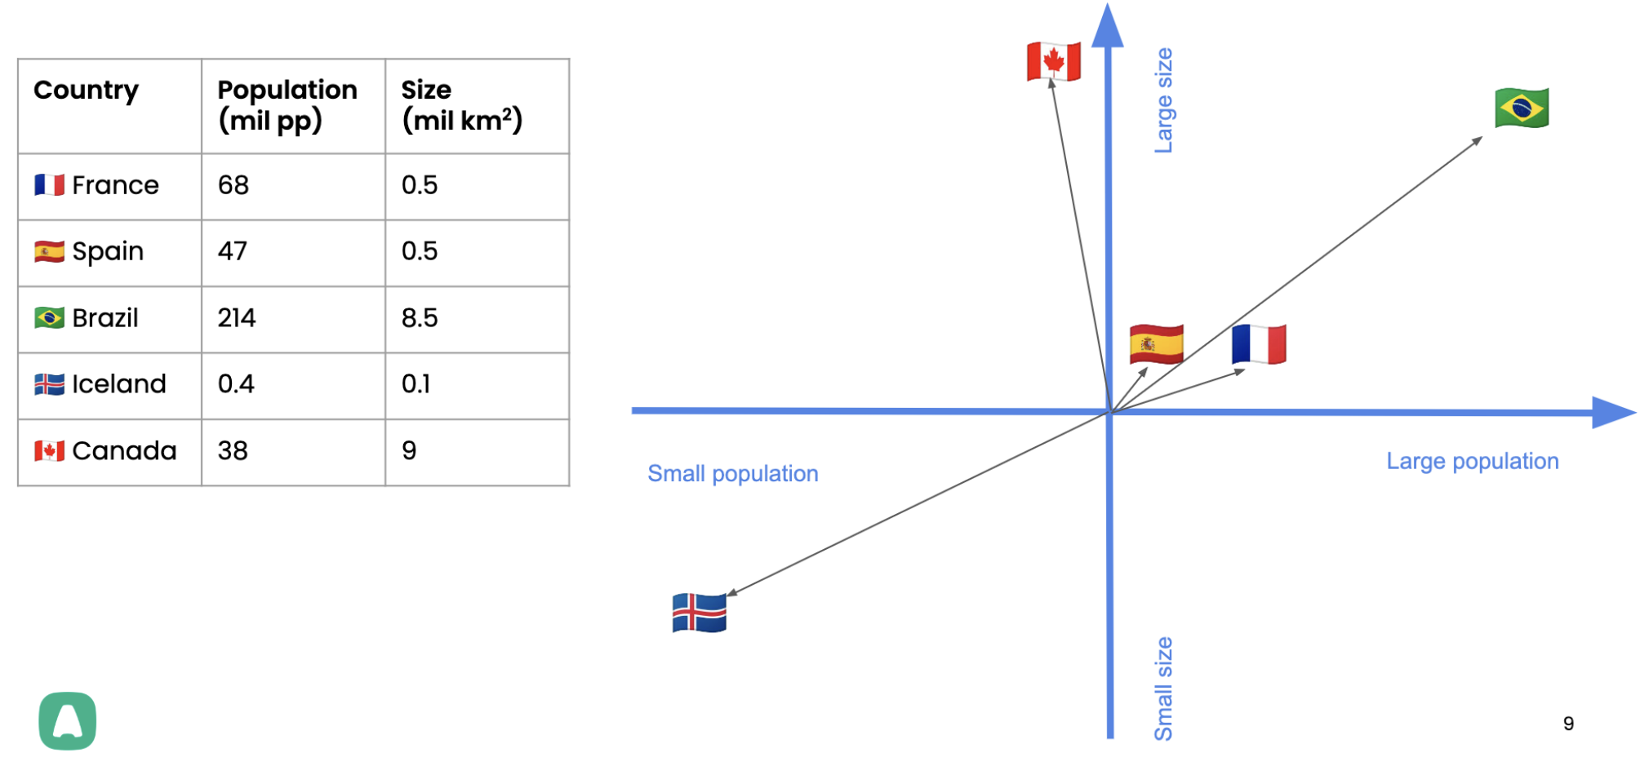

Slide 8
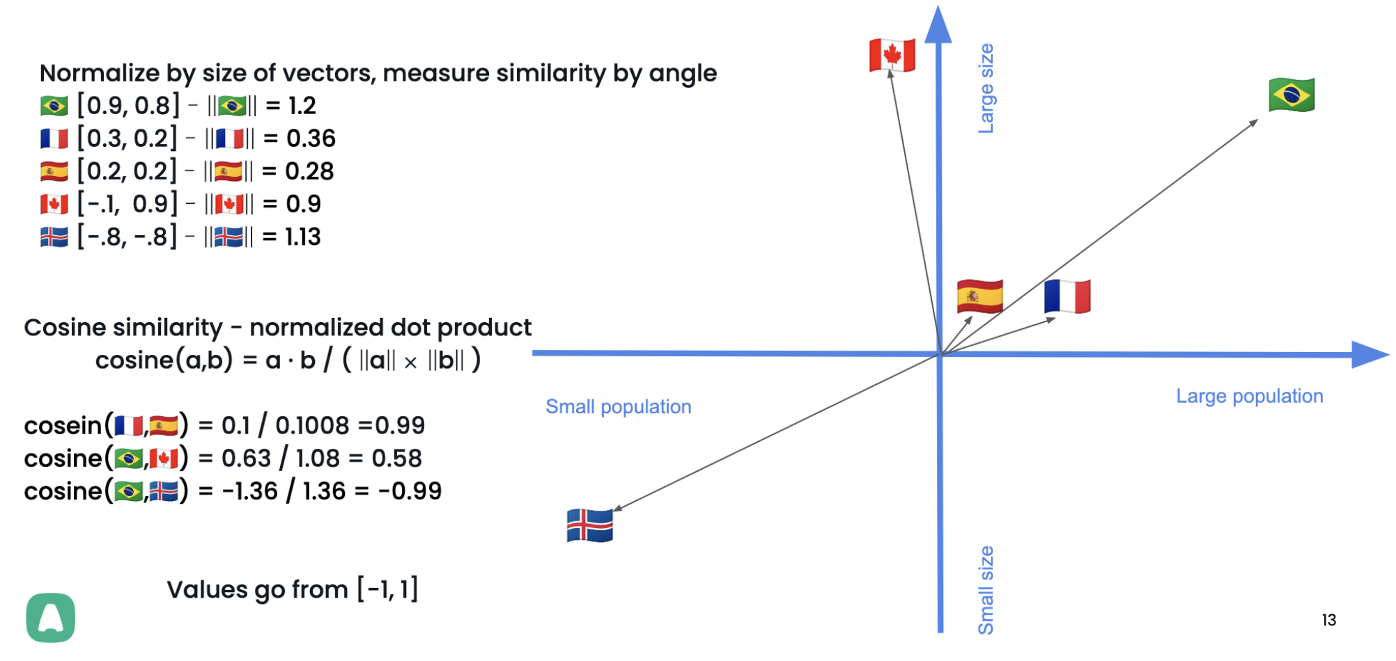

Slide 9
This can be done!
Word embeddings can be automatically calculated
Using self-supervised machine learning
Based on word co-occurrences

Slide 10

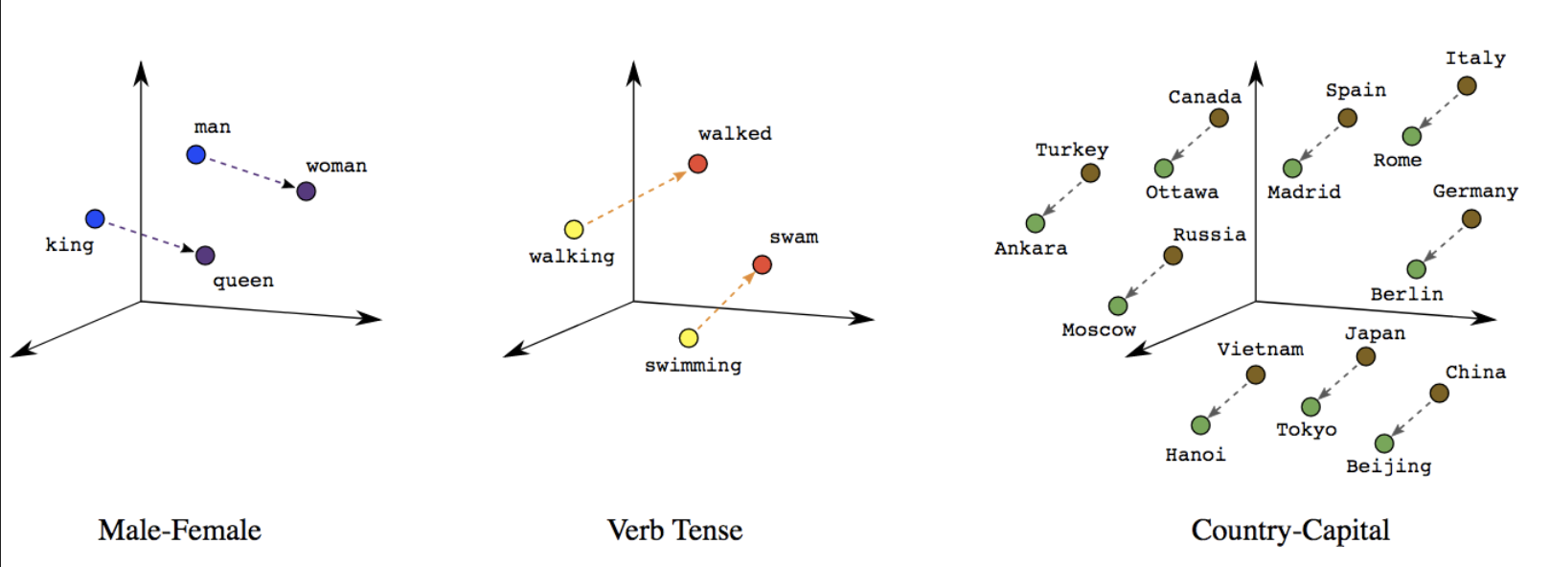
Word2Vec (2013)

Slide 11
Distributional semantics
Words occurring in a similar context
tend to have similar meaning
Context ~ Meaning

Slide 12
Distributional semantics
To start my day, I drink hot coffee in the mornings
Sipping some warm tea helps me wake up in the morning
Context:
coffee drink, hot, mornings
tea sipping, warm, wake up, morning

Slide 13
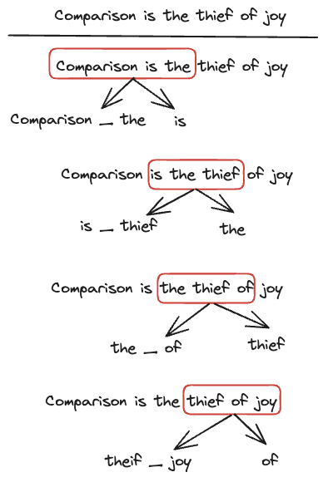
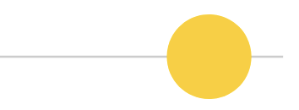
ML Objective
DataSet
Given context words, predict target word
Text corpus (coherent text)
Self supervised
Masked target word, use sliding window

Slide 14
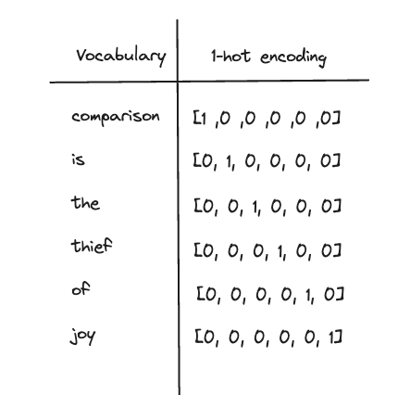
Set up

Slide 15
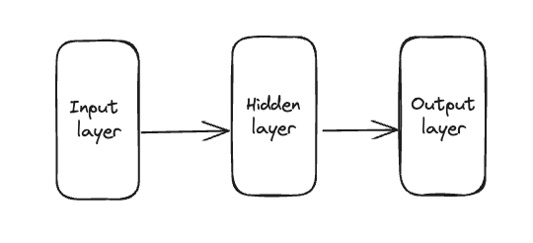
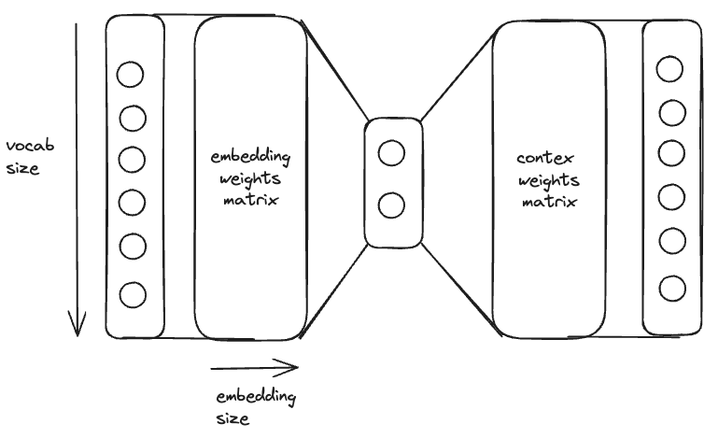

Model Architecture

Slide 16
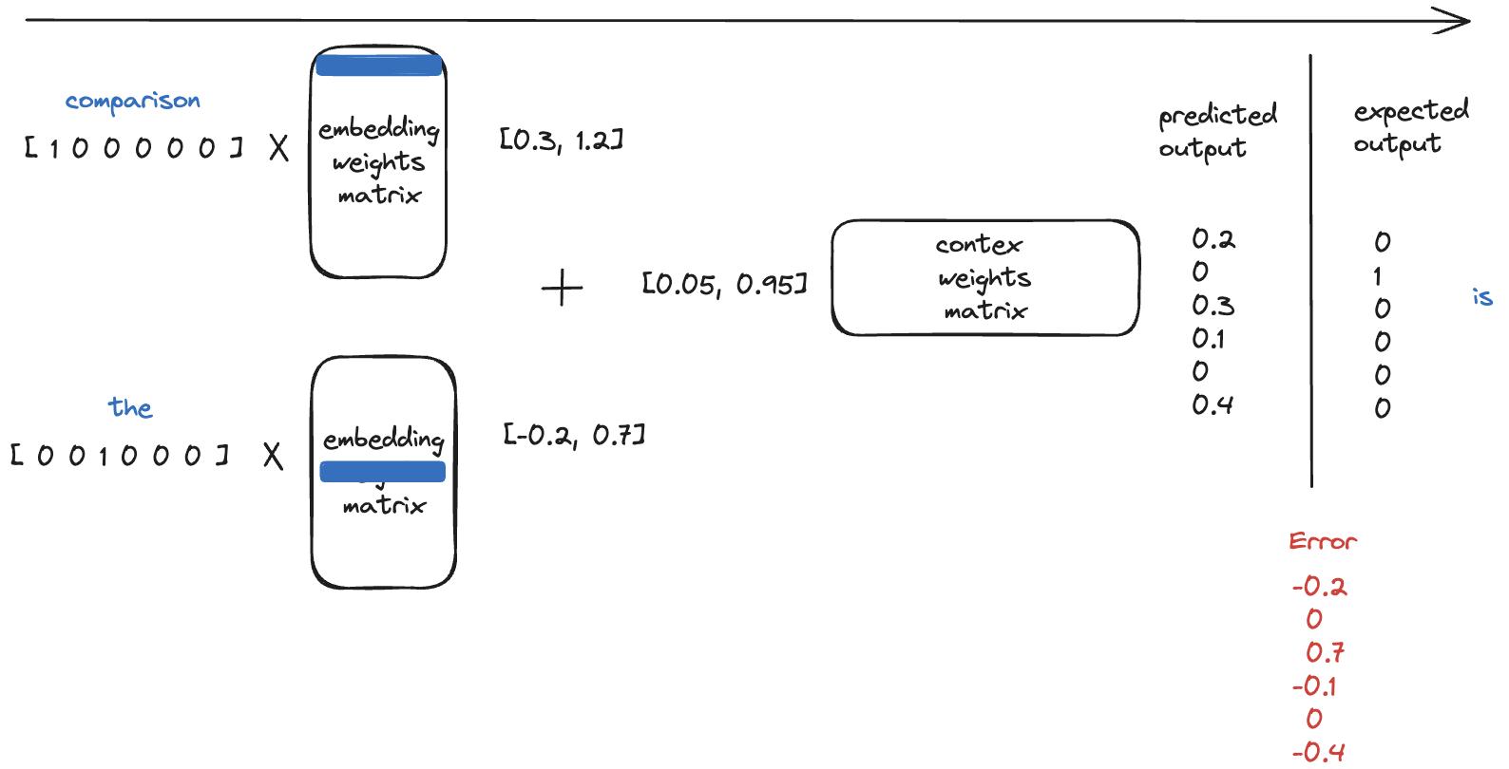
Prediction - Forward Pass

Slide 17
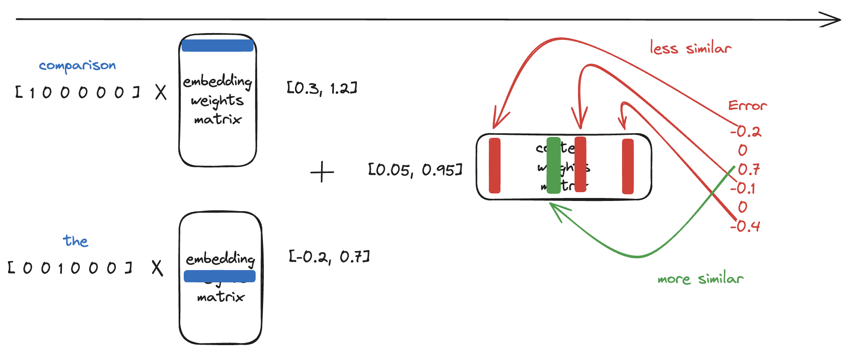


Error Back Propagation 1

Slide 18
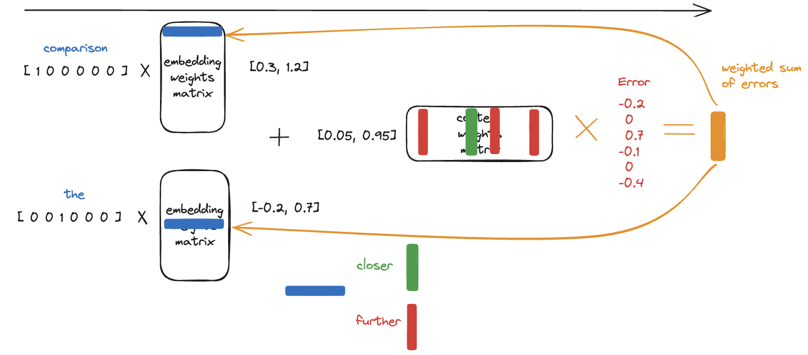
Error Back Propagation 2

Slide 19
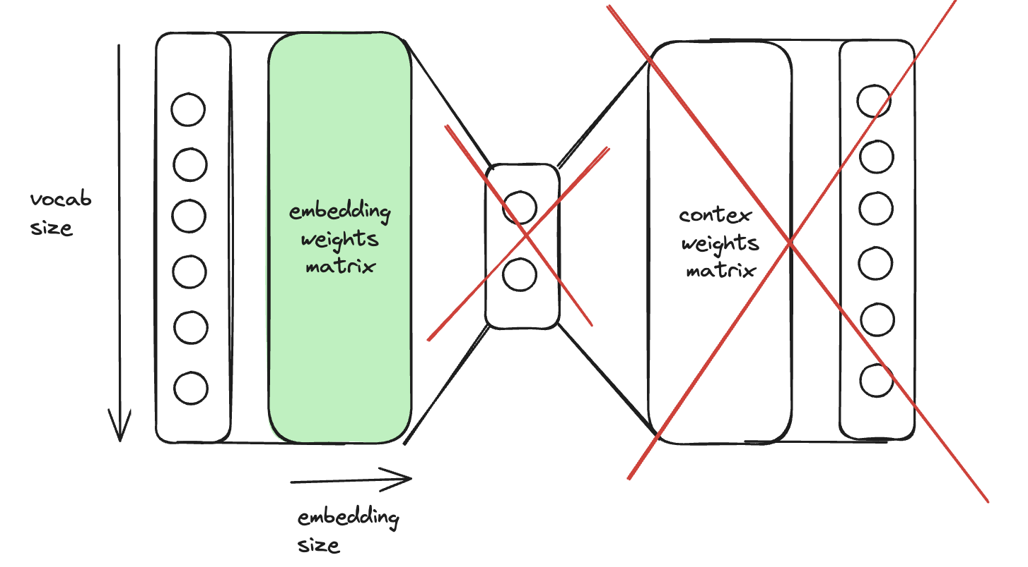
New goal
target word prediction will not be great
in the process we generate high-quality word embeddings, which can be used to train language models more efficiently

Slide 20
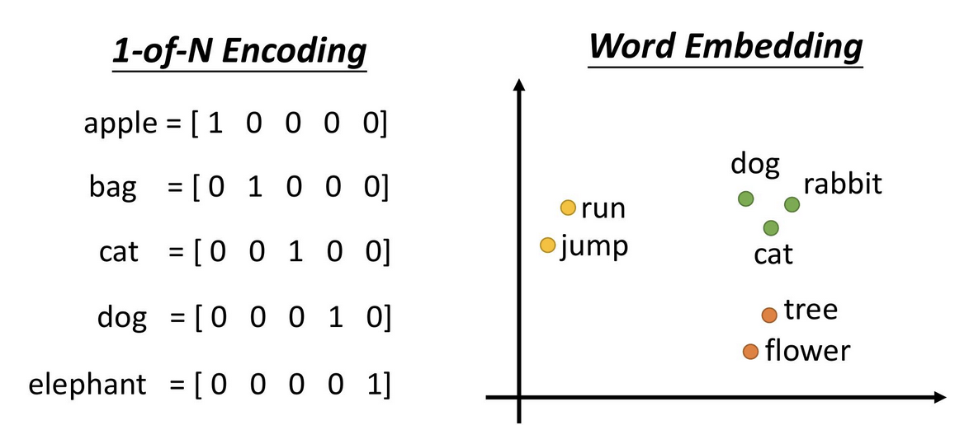
Result

Slide 21
Surprising result
word meaning can be represented well using vectors calculated, based on co-occurrence
despite starting from a blank state (random vectors)
despite not being taught a single rule of English syntax
despite not being associated with a knowledge graph

Slide 22
Summary - How it’s made?
First it seems like magic
Matrix multiplications and error backpropagation
Still feels like magic

